Slide 1
Summer Term 22 Machine Learning on Spatio-Temporal Graphs Org & Introduction
Prof. Dr. Holger Giese (holger.giese@hpi.uni-potsdam.de)
Christian Medeiros Adriano (christian.adriano@hpi.de) - “Chris”
Matthias Barkowsky (matthias.barkowsky@hpi.de)
Iqra Zafar (iqra.zafar@hpi.de)

Slide 2
Key Facts
Weekly Hours: 4
Credit Points: 6
Teaching Form: Project Seminar
Enrolment Type: Compulsory Elective Module (“Wahlpflichtmodul”)
Course Language: English
Study Programs and Modules:
IT-Systems Engineering MA
Specialization module(s): „Software Architecture & Modeling Technology“ (SAMT)
Data Engineering MA
CODS: Complex Data Systems
Digital Health MA
SCAD: Scalable Computing and Algorithms for Digital Health

Slide 3
Dates
Enrollment deadline: 01.04.2022 – 30.04.2022
Introductory meeting: 26.04.2022 [NOW]
Meetings:
Lectures - scheduled
Update meetings – on demand, usually weekly
Final Presentations at end of the semester: To be decided
Presentations will be at the lecture room and the participants will be able to join via Zoom.

Slide 4
Communicantion Plan
Motive | Content | Medium
Artifacts | Source code, Data Documentation, Wiki | Github - https://github.com/orgs/hpi-sam/
Papers | Copyrighted material | Zotero
Messaging ad hoc | Questions, Suggestions, Sharing | Our Slack group: Send email to christian.adriano@hpi.de
Official communications | Schedule, Orientations, Administrative issues | Email christian.adriano@hpi.de
Meetings | Lectures, Status, Work meetings | Zoom, Skype
Emergency | Call, SMS, messaging | Chris mobile number (check Chris’ Slack profile)

Slide 5
Project Proposal
Team size: up to four (preferred)
Project proposal in two stages:
1- State-of-art (1 page, double column) – ~ in approx. 6 weeks
covering at least 5 well-selected papers per person
2- Proposal - first draft ~ in approx. 8 weeks
Detail the problem (what is it? why should I care?, why is it challenging?)
Describe the scenario (source, size, main features, cite any papers that used it)
Determine the methods that you plan to use (preliminary insights, it might change)
Discuss how you will evaluate your results (benchmarks, baselines, null-models)

Slide 6
Roadmap (1/2)
Project Phase 1: Learn fundamentals - Lectures
Goal: learn fundamentals
Deadline: Mid-End of May
Two lectures per week (Tuesday and Wednesday 11:00)
Project Phase 2: Present Proposal - Reading and Writing
Goal: learn about the state of art of one application area
Project Phase 3: Apply a method - Coding and Evaluation
Goal: learn to apply and evaluate a method
Present update in weekly meetings (either Tuesday and Wednesday 11:00)
Final Presentations in one session in late July 2022
Submission of final report one week after the presentation

Slide 7
Road Map (2/2)
Graph Basics
Metrics and Random Models
Graph Structural Features – Clustering
Graph Algorithms
Graph Embeddings
Message Passing
Graph Convolutional Networks
Sequential Graph Data
Graph Attention Networks
Graph Evolution Networks
Temporal Graph Networks
Propagation Graph Neural Networks
Network Effects, Cascading and Contagion
Outbreak Detection and Influence Maximization

Slide 8
Datasets and Tools
Datasets
http://networkrepository.com/
https://snap.stanford.edu/data/
https://networkdata.ics.uci.edu/
Tools (sorted by priority)
cuGraph: https://github.com/rapidsai/cugraph (Strongly recommend, fast)
NetworkX: https://networkx.org/documentation/stable/tutorial.html (great coverage of graph algorithms)
Snap for Python: http://snap.stanford.edu/snappy/index.html
Pytorch Geometric: https://pytorch-geometric.readthedocs.io/en/latest/
Github project: https://github.com/orgs/hpi-sam/projects/3

Slide 9
Seminar Work, Deliverables and Grading
Seminar work alone or in groups on one selected topic/project.
Each team is supervised individually by a teaching assistant.
Weekly update meeting
Intermediary Presentations
Written deliverables: [80% of final grade]
Final report on findings
Length: 6 to 10 pages ACM Format per team
Some parts must be attributable to each individual author
Final Presentations: [20% of final grade]
Presentation on findings
Questions and feedback for other students' presentation

Slide 10
Next Task
Send an email to christian.adriano@hpi.de
Accept invitation to Slack, Zotero, and GitHub project
Select one of the survey papers to read
Write a gist (context, problems, approaches) 2 to 3 slides.

Slide 11
Motivation for Learning on Graphs and GNNs

Slide 12
Scenarios and Network Types
Network Types
Event graphs
Disease pathways
Knowledge-graphs
Scene graphs
Heterogeneous graphs (different types of nodes and edges)
Scenarios
Clustering in social network
Protein interaction
Cell similarity networks
Failure propagation in infrastructure networks
Fake news detection
Side-effects of drugs
Network attacks
Traffic jams

Slide 13
Types of Predictions
Node classification
What type of node is this?
Link prediction
Are these two nodes connected?
With which strength?
Graph Classification
Patterns of connectivity (motifs)
Network similarity (isomorphism)
Notes:
Leskovec, Jure, et al. "Community structure in large networks: Natural cluster sizes and the absence of large well-defined clusters." Internet Mathematics 6.1 (2009): 29-123.

Slide 14
Basic Concepts

Slide 15
Types of graphs
Directed
Undirected
Disconnected
Fully connected
A
A
A
A
B
B
B
B
C
C
C
C
D
D
D
D
Directed Acyclic Graph
Multigraph
Bipartite
Cliques
E
A
A
A
A
B
B
B
F
B
C
C
C
D
D
D
C
D
Ego network of A

Slide 16
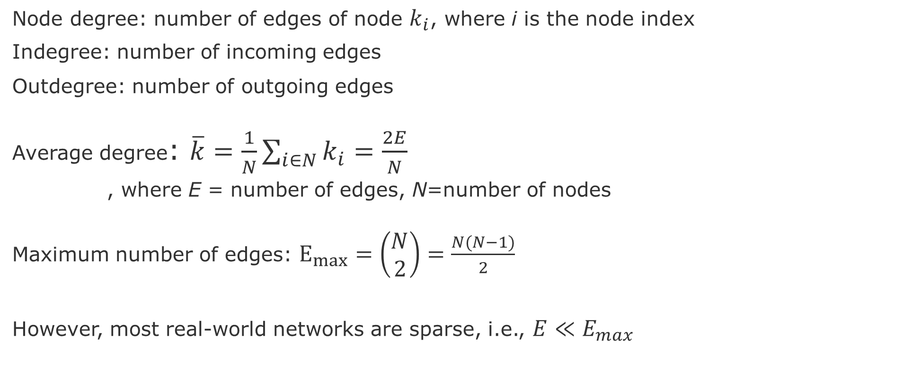
Node and Edge degrees
Node degree: number of edges of node $k_{i}$, where i is the node index
Indegree: number of incoming edges
Outdegree: number of outgoing edges
Average degree: $\overline{k}=\frac{1}{N}\sum_{i∈N}{k_{i}}=\frac{2E}{N}$
, where E = number of edges, N=number of nodes
Maximum number of edges: $E_{max}=\left(\begin{aligned}N \\ 2\end{aligned}\right)=\frac{N(N−1)}{2}$
However, most real-world networks are sparse, i.e., $E≪E_{max}$
Notes:
Leskovec, Jure, et al. "Community structure in large networks: Natural cluster sizes and the absence of large well-defined clusters." Internet Mathematics 6.1 (2009): 29-123.

Slide 17
Adjacency matrix
 | A | C | D | B | E | F
A | 1 | 1 | 1 | 1 | 0 | 0
C | 1 | 0 | 1 | 1 | 0 | 0
D | 1 | 1 | 0 | 1 | 0 | 0
B | 1 | 1 | 1 | 0 | 1 | 1
E | 0 | 0 | 0 | 1 | 0 | 1
F | 0 | 0 | 0 | 1 | 1 | 0
Cliques
E
A
F
B
C
D
However, adjacency matrix of real-world networks are full of zeros

Slide 18
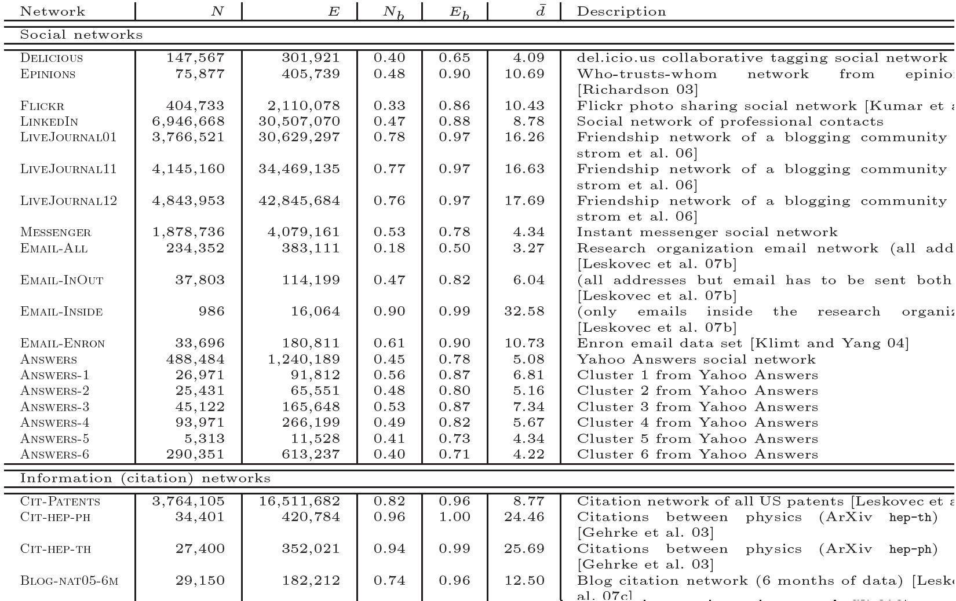
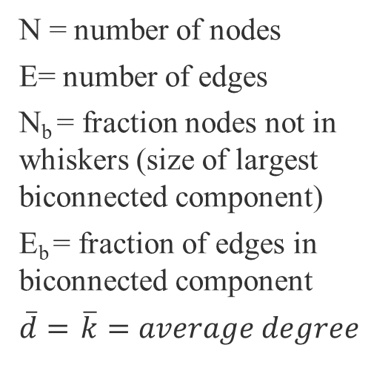
Most real-world networks are sparse
N = number of nodes
E= number of edges
N_{b} = fraction nodes not in whiskers (size of largest biconnected component)
E_{b} = fraction of edges in biconnected component
$\overline{d}=$ $\overline{k}=average degree$
source :Leskovec, J., et al. "Community structure in large networks: Natural cluster sizes and the absence of large well-defined clusters." Internet Mathematics 6.1 (2009): 29-123.

Slide 19
END

